Slide 1



Electrical Engineering Department
JECRC , Jaipur
TESLA 01/18
TESLA 01/18
January
2018

Slide 2

TESLA
01/18
What’s
Inside....??
1. Director’s message
2. Principal’s message
3. HOD’s message
4. Vision, Mission of Institute
5. Vision, Mission of Department
6. Program Outcomes
7. Placed Students
8. Career Seminar
9.. Guest Lecture
10 Faculty’s Achievements
11. Student’s Achievements
12. Editorial Board

Slide 3

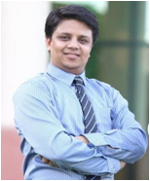

TESLA 01/18
Director JECRC, Jaipur
Message
The JECRC Foundation has been established with a view to provide world class education to our young minds so that they can shoulder their global responsibilities in the years to come.
The JECRC Foundation, now 18 years old, has established itself as one of the leading self-financed colleges in Northen India. This has been primarily due to the large significance that the college puts on the teaching learning process.
The focused areas at JECRC now, apart from teaching learning and placement would be research and development, entrepreneurship and outreach. We also strive to help our students in maintaining and spreading the rich Indian culture and lead the world as our country has done in the past. As you move ahead and rise higher in your life, you must entrench yourself in this unique realm that our culture endows us.
I wish to convey my greetings to all our Alumni and wish each one of them all success in their personal and professional lives.
Best Wishes
Mr. Arpit Agrawal
Director
JECRC, Jaipur

Slide 4
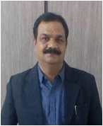
TESLA 01/18
Principal JECRC, Jaipur
Message
A desire can change nothing, a destination can change something but a determination can change everything. Life is a set of problems, an engineer has to solve the problems in their domain areas with strong innovative ideas and scientific knowledge. Your commitment to become an engineer by denoting your journey in Jaipur Engineering College and Research Center will be fruitful and enjoyable in every aspect, the experience you gain from here and the moments you spend here.
Best Wishes
Dr. V. K. Chandna
Principal
JECRC, Jaipur

Slide 5
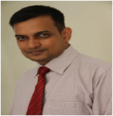
TESLA 01/18
HOD (EE)
JECRC, Jaipur
Message
Nikola Tesla, the well known Serbian- American electrical engineer is quoted as saying "Electrical sources has revealed to us the true nature of light has provided us with innumerate appliances and instruments of precision and has thereby vastly added to the exactness of our knowledge". His words portray the immensely wide and dynamically changing and ever developing world of electrical engineering open to electrical engineer.
It is a great pleasure to see the January, 2018 issue of EE newsletter “Tesla 01/18”. The department has well qualified staff with expertise in Power Systems, Control Systems, Power Electronics and Drives, Electrical Machines and Renewable Energy System assisted by skilled supporting staff. I would like to thank my existing team for their commitment and hard work. The department seeks to combine excellence in education and research. The core values of the department help the students to develop the students their overall personality and made them worthy technocrat to compete and work at global level. Our department has been conducting hands on workshop/seminar/training program since its beginning to keep the faculty and students to enhance the knowledge in their domain.Our mission includes a commitment to prepare students for professional and research activities with an ability to learn independently. I wish you all a successful, long-lived, engineering-based career path.
Best Wishes
Dr. Sandeep Vyas
HOD, Electrical Engineering
JECRC, Jaipur

Slide 6

Vision of the Institute
TESLA 01/18
To become a renowned centre of outcome based learning, work towards academic, professional, cultural and social enrichment of lives and communities .
Mission of the Institute
Focus on evaluation of learning outcomes and motivate student to inculcate research aptitude by project based learning.
Identify, based on informed perception of Indian, regional and global needs, the areas of focus and provide platform to gain knowledge and solution.
Offer opportunities for interaction between academia and industry.
Develop human potential to its fullest extent so that intellectually capable and imaginatively gifted leaders may emerge in the range of profession.

Slide 7
Vision of Department
TESLA 01/18
To Emerge as a Centre of Excellence in teaching in the area of Electrical Engineering; to serve as a valuable resource for society by promoting excellence.
Mission of Department
M1: To provide professional and ethical guidance to the students to make them employable .
M2: To improve quality of education through different quality development programs for faculty and students .
M3: To encourage students to acquire practical knowledge through projects and participation in national and international events .
M4: To prepare our students for upcoming challenges of life through guidance for competitive examinations .
4

Slide 8
TELSA
01/18
PROGRAM OUTCOMES
Engineering knowledge: Apply the knowledge of mathematics, science, engineering fundamentals, and an engineering specialization to the solution of complex engineering problems.
Problem analysis: Identify, formulate, research literature, and analyze complex engineering problems reaching substantiated conclusions using first principles of mathematics, natural sciences, and engineering sciences.
Design/development of solutions: Design solutions for complex
Engineering problems and processes that meet the
design system components or specified needs with appropriate
consideration for the public health and safety and the cultural, social, and environmental considerations.
Conduct investigations of complex problems: Use research-based knowledge and research methods including design of experiments, analysis and interpretation of data, and synthesis of the information to provide valid conclusions.
Modern tool usage: Create, select, and apply appropriate techniques, resources, and modern engineering and IT tools including prediction and modelling to complex engineering activities with an understanding of the limitations.
The engineer and society: Apply reasoning informed by the contextual knowledge to assess societal, health, safety, legal and cultural issues and the consequent responsibilities relevant to the professional engineering practice.
4

Slide 9
TESLA 01/18
Environment and sustainability: Understand the impact of the professional engineering solutions in societal and environmental contexts and demonstrate the knowledge of and need for sustainable development.
Ethics: Apply ethical principles and commit to professional ethics, responsibilities and norms of the engineering practice.
Individual and team work: Function effectively as an individual and as a member or leader in diverse teams, and in multidisciplinary settings.
Communication: Communicate effectively on complex engineering activities with the engineering community and with society at large, such as, being able to comprehend and write effective reports and design documentation, make effective presentations and give and receive clear instructions.
Project management and finance: Demonstrate knowledge and understanding of the engineering and management principles and apply these to one’s own work, as a member and leader in a team, to manage projects and in multidisciplinary environments.
Life-long learning: Recognize the need for, and have the preparation and ability to engage in independent and life-long learning in the broadest context of technological change.
4

Slide 10
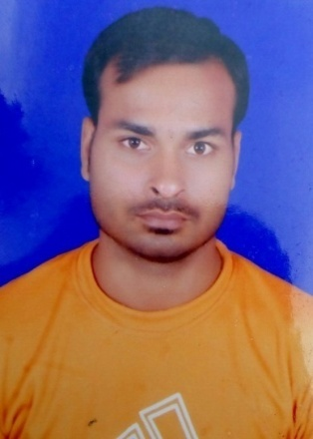
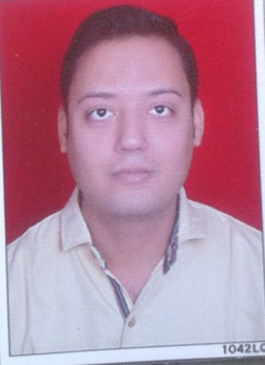
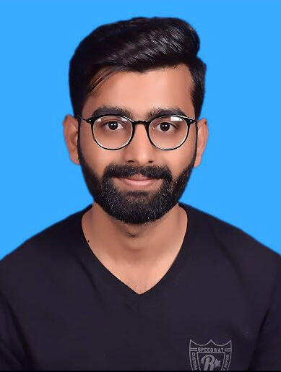
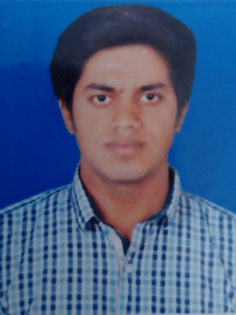
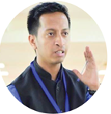
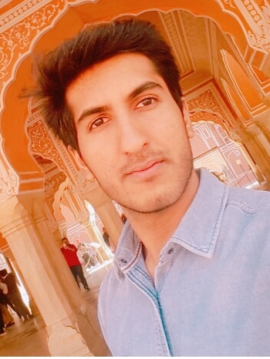
TELSA 01/18
PLACEMENT DRIVES
Talent Pull Drive-The Talent Pull came for the campus placement on 1st Dec and they conducted a lot of activities for the selection process of students which included aptitude test at first and then it was followed by GD and personal interview . Four students were selected from EE department named as Mr.Akshant Kumar, Mr.Abhishek Jain, Mr.Kathans Sundrawat, Mr.Vikram K. Jha with the package of 2.4 LPA
BYJU’S Drive- The BYJU’S came for the campus placement on Dec and they conducted a lot of activities for the selection process of students. Two students were selected from the EE department named as Mr. Ayush Bhatnagar, Mr. Himshikhar Chamoli with the package of 9.0 LPA.

Slide 11
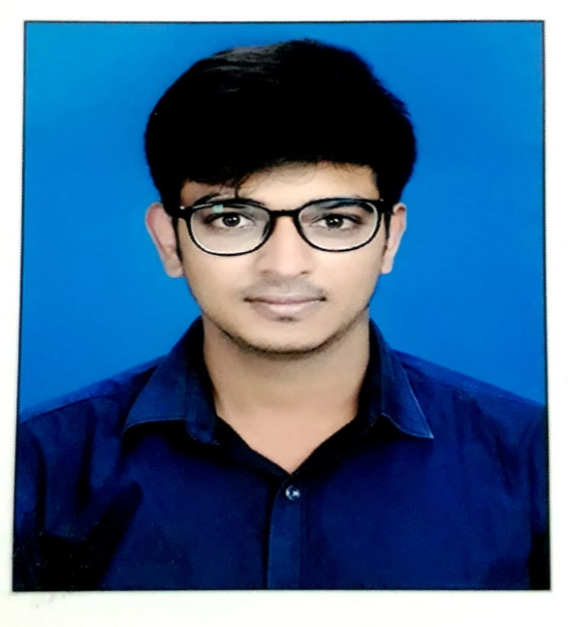
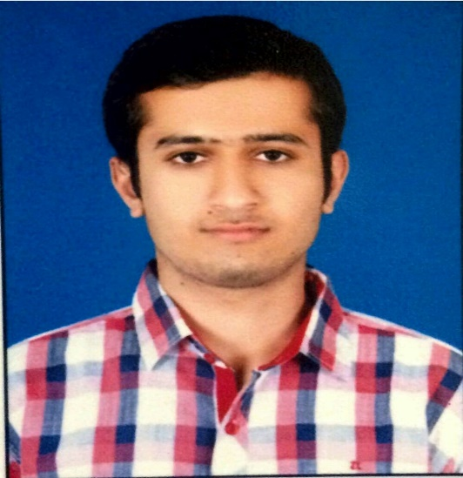
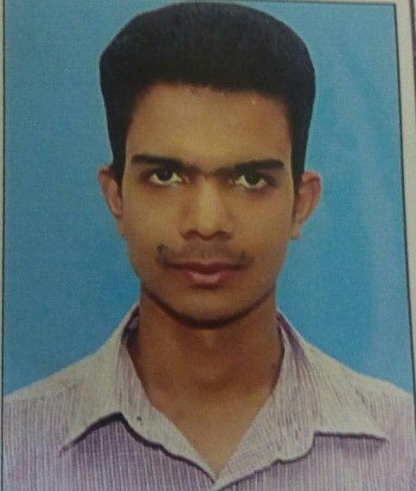
TESLA 01/18
Tata Consultancy Service- Mr. Manu Singhal is selected in Tata Consultancy Service with the package of 2.64 LPA.
Off Campus placement Drive- Mr. Kuljot Singh and Mr. Sandeep Pareek are selected in Focus Academy for Career Enhancement with the package of 2.64 LPA.
4

Slide 12
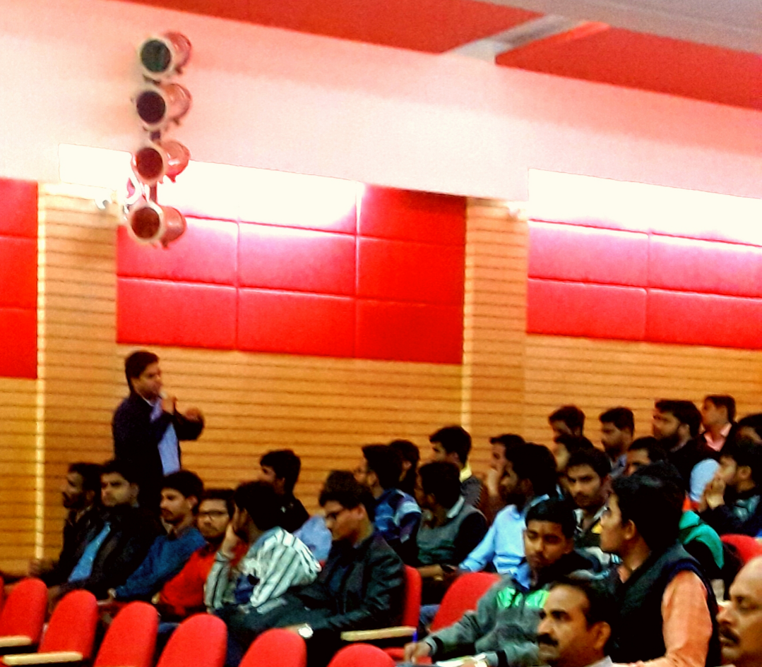
TESLA 01/18
CAREER SEMINAR
The Electrical Department of JECRC foundation organized a career seminar on: Opportunities for Electrical Engineers after B. Tech by a faulty member from Engineer's Academy on 23 Jan 2018 from 1:00 to 3:00 pm in JECRC Auditorium (A block) . In this seminar, he shared brief introduction about the opportunities for electrical engineers after B.Tech. the vote of thanks was proposed by Mr. Vishal Sharma and he is also coordinator of this seminar.
4

Slide 13
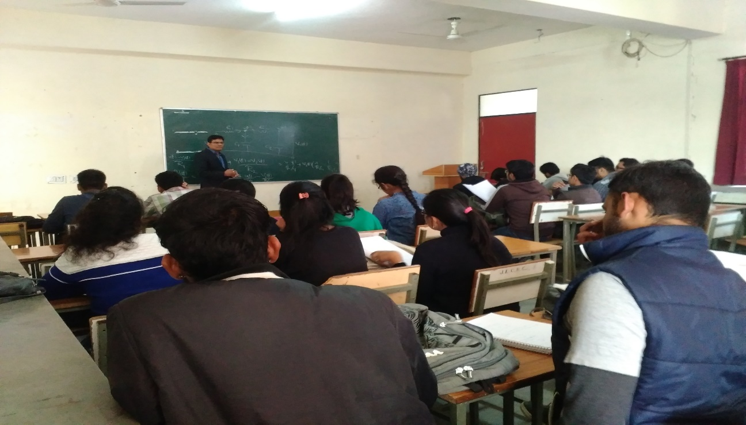
TESLA 01/18
GUEST LECTURE
The Electrical Department of JECRC foundation organized a guest lecture by two highly eminent personalities from Engineer's Academy on 31st jan, 2018. The event was graced by Mr.Narsingh Bhadoria who did his M.tech from IIT Roorkee and has more than 4 years teaching experience for GATE students.He took the lecture on the topic High frequency amplifier or Tuned amplifier from the subject Analog Electronics for the students of 4th semester.And the second guest lecture was followed by explaining the State Space Variable from the subject Control System by Mr.Manoj Yadav who also did his M.tech from IIT kanpur and has more than 4years teaching experience for GATE students.
.
4

Slide 14
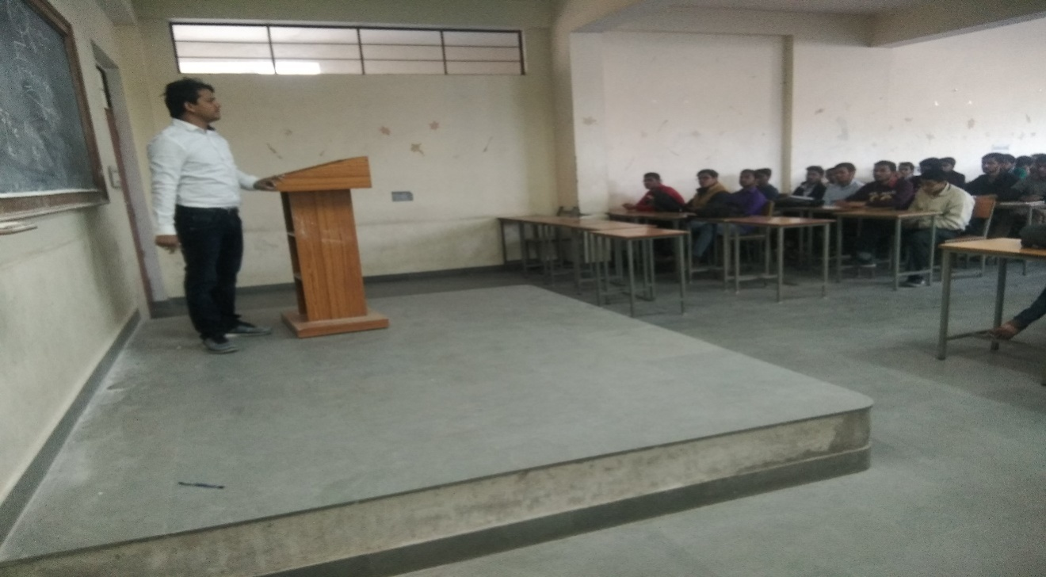
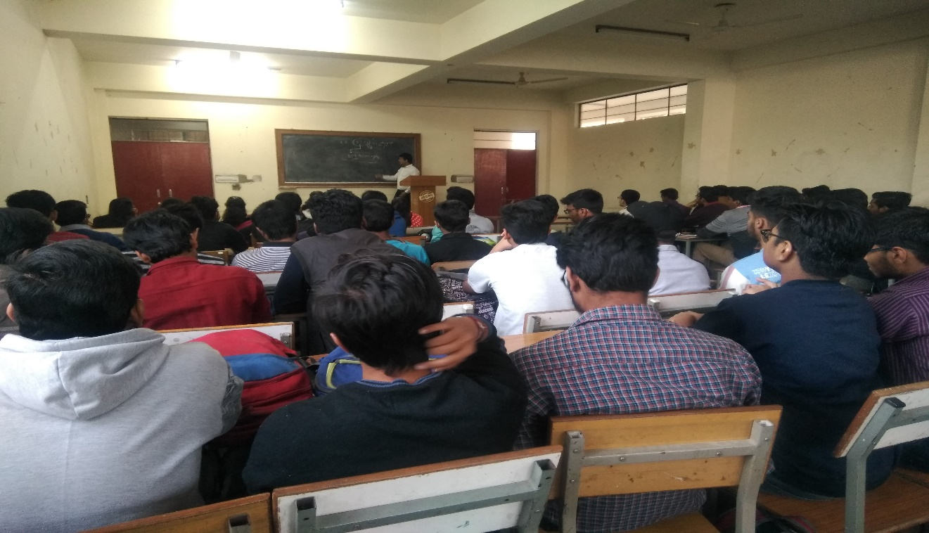
TESLA 01/18
At the end of session the team of Engineer's Academy also shared few tips for the preparation of GATE, PSU'S etc. The students were highly enlightened and we're able to understand the concepts very well. Mr. Vishal Sharma is the coordinator of this.
4

Slide 15
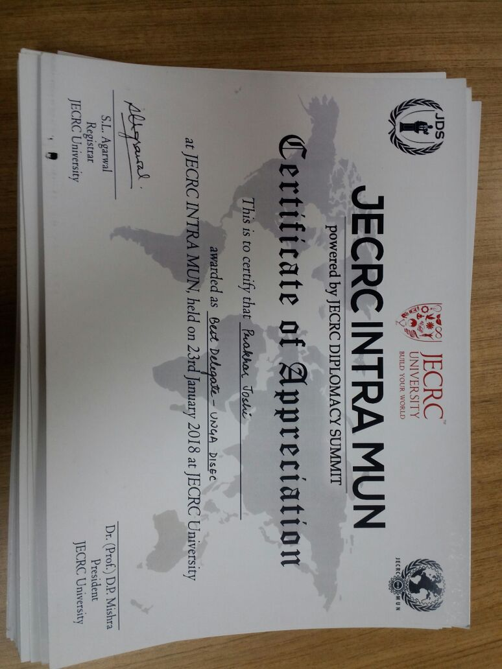
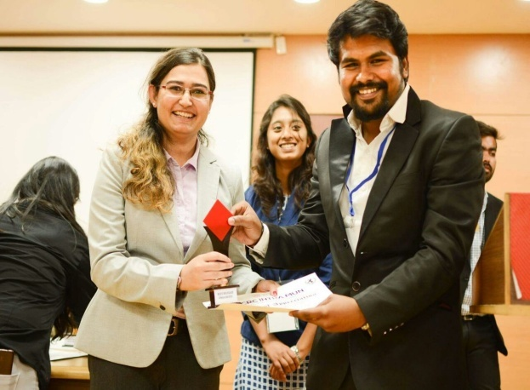
TESLA 01/18
STUDENTS ‘S ACHIEVEMENTS
Mr. Kapil Bindal student of 4th year got selected in CAT 2018 exam scoring 95.16 percentile .He has been shortlisted for admission to:
IIM Bhodhgaya
IIM Kashipur
IIM Raipur
IIM Ranchi
IIM Rohtak
IIM sambalpur
IIM Sirmaur
IIM Udaipur
IIM Tiruchirappalli
Mr. Prakhar Joshi students of 3rd year won Best Delegate prize in INTRA-MUN JECRC 2018 held at JECRC University.
4

Slide 16
TESLA 01/18
FACULTY’S ACHIEVEMENTS
Publications-
Mr. Gopal Tiwari
Paper Name-Design and Development of Vehicle Driving Safety System Using Microcontroller
Name of Conference- ICRITETR-2017 , Jaipur
Status( Communicated/published)- Published on 24/12/2017
ISSN No- 978-93-5291-761-7
Mr. Ram Singh
Paper Name-Design and Development of Vehicle Driving Safety System Using Microcontroller
Name of Conference- ICRITETR-2017 , Jaipur
Status( Communicated/published)- Published on 24/12/2017
ISSN No- 978-93-5291-761-7
Mr. Ram Singh
Paper Name-Outcome Based Assessment of Engineering undergraduate final Year Projects for tire-2 Institutes
Name of Conference-International Conférence on Inventive Computation Technologies-18
Status( Communicated/published)- Published on 18/12/2017
ISBN No- 2194-5357, ISSN: 1381-2416
Mr. Gopal Tiwari
Paper Name-Outcome Based Assessment of Engineering undergraduate final Year Projects for tire-2 Institutes
Name of Conference-International Conférence on Inventive Computation Technologies-18
Status( Communicated/published)- Published on 18/12/2017
ISBN No- 2194-5357, ISSN: 1381-2416

Slide 17
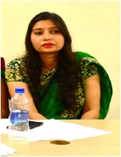
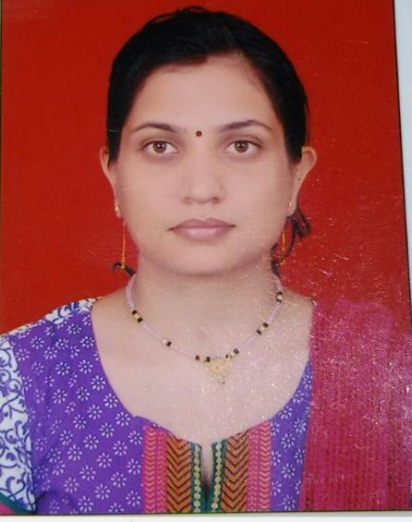
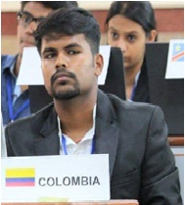
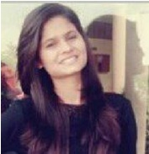
TESLA 01/18
EDITORIAL BOARD
Faculty Coordinators
Ms. Ravita Saraswat
Ms. Yajusha Sharma
Student Coordinators
Prakhar Joshi
Bharti Sharma

Slide 18
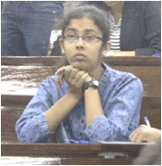
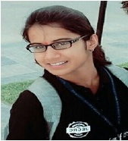
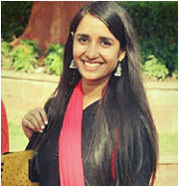
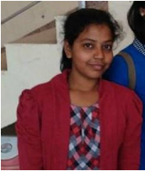
TESLA 01/18
Sakshi Sharma (3rd year)
Akanksha Sinha (3rd year)
Manu Sharma (3rd year)
Mridula Soni (3rd year)

Slide 19
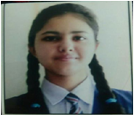
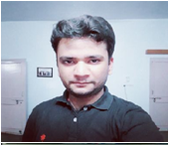

TESLA 01/18
Ujjwal Sharma (2nd year)
Shashwat Tripathi (2nd year)

